Slide 1


Student Details
Name: Nikhitha Yarajarla
SkillsBuild Email Id: nikhitha_yarajarla@srmap.edu.in
University Name: SRM University, Andhra Pradesh
Internship Domain: Artificial Intelligence &
Machine Learning
Internship Start Date And End Date: 03/07/2024 to 31/07/2024

Slide 2
Employee burnout prediction
PROBLEM STATEMENT:
The initiative employs focused interventions based on the analysis to improve employee engagement, develop a healthy work environment, and lessen burnout, all of which contribute to the success and expansion of the organization.
Using data-driven insights and predictive modeling, the project examines employee burnout to determine its origins, signs, and risk factors within the company.

Slide 3
AGENDA
Project Overview
End Users
Solution and Value Proposition
Customization for an Organization
Modelling
Results
Links

Slide 4
PROJECT OVERVIEW
A condition of extreme and protracted stress-related physical, emotional, and mental tiredness is known as employee burnout. It may have detrimental effects on a person's health as well as lower output and performance at work. Maintaining the health and well-being of employees in today's fast-paced, always-connected society requires recognizing and addressing the warning symptoms of burnout. We'll investigate how regression analysis can be used to forecast staff burnout.
We can build a model to identify people at risk of burnout by analyzing a dataset comprising several aspects that may contribute to burnout, such as workload, mental exhaustion, job, and work-life balance. Organizations can assist in preventing burnout and support employee well-being by proactively addressing these risk factors.

Slide 5
WHO ARE THE END USERS of this project?
Organization Leadership: Uses predictive insights to make strategic decisions to enhance employee well-being and organizational performance..
Human Resources (HR) Department: Implements targeted interventions to reduce burnout and improve employee satisfaction and retention.
Managers and Supervisors: Identifies at-risk employees and takes proactive steps to support their teams and prevent burnout
Employees: Gains awareness of their own risk factors and receive support to maintain a healthy work-life balance.

Slide 6
YOUR SOLUTION AND ITS VALUE PROPOSITION
Solution:
The solution is to use linear regression to build a predictive model that can forecast and analyze employee burnout rates. Based on a dataset from Kaggle, this model analyses a variety of employee-related variables, including Employee ID, Date of Joining, Gender, Company Type, Availability of WFH Setup, Designation, Allocation of Resources, Mental Fatigue Score, and Burn Rate.

Slide 7
Value Proposition:
Enhanced Employee Well-Being: Promotes a healthier work environment.
Improved Productivity: Healthy, motivated employees are more productive.
Data-Driven Decision Making: Empowers HR and management with actionable insights.

Slide 8
How did you customize the project and make it your own
Understanding the Organizational Context: Tailor the system to fit the organization’s unique environment and dynamics.
Utilizing Advanced Data Processing Techniques: Use sophisticated methods for handling and analyzing complex datasets.
Selecting and Adapting the Right Model: Choose and fine-tune models to meet specific prediction needs.
Incorporating Psychological Factors: Integrate psychological aspects for a comprehensive view of burnout.
Establishing Continuous Improvement Practices: Set up processes for regular evaluation and system enhancement.

Slide 9
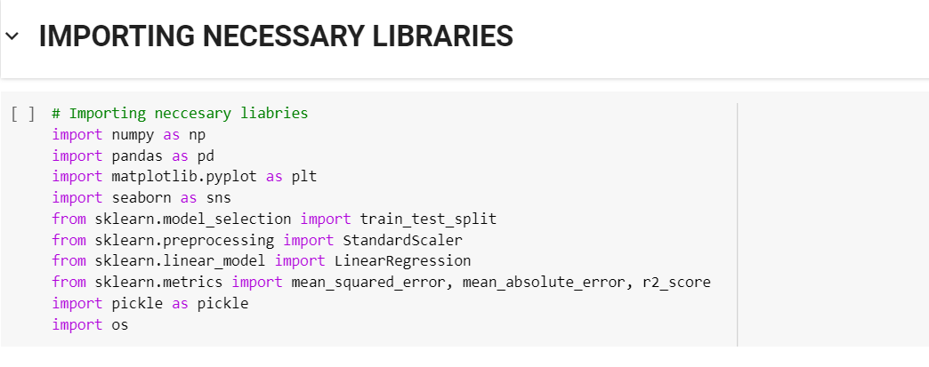
MODELLING

Slide 10
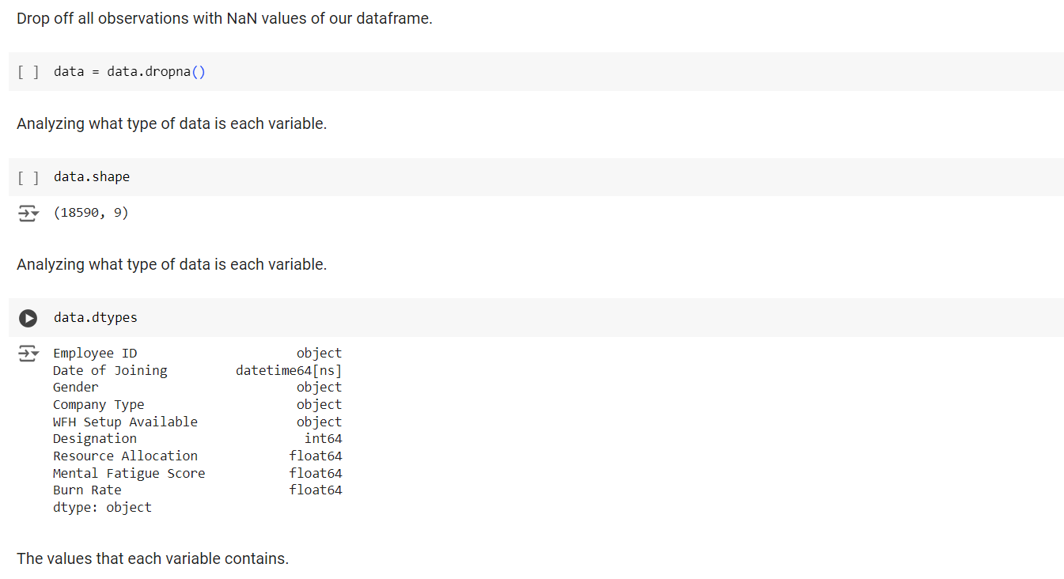
Handling Missing Values

Slide 11
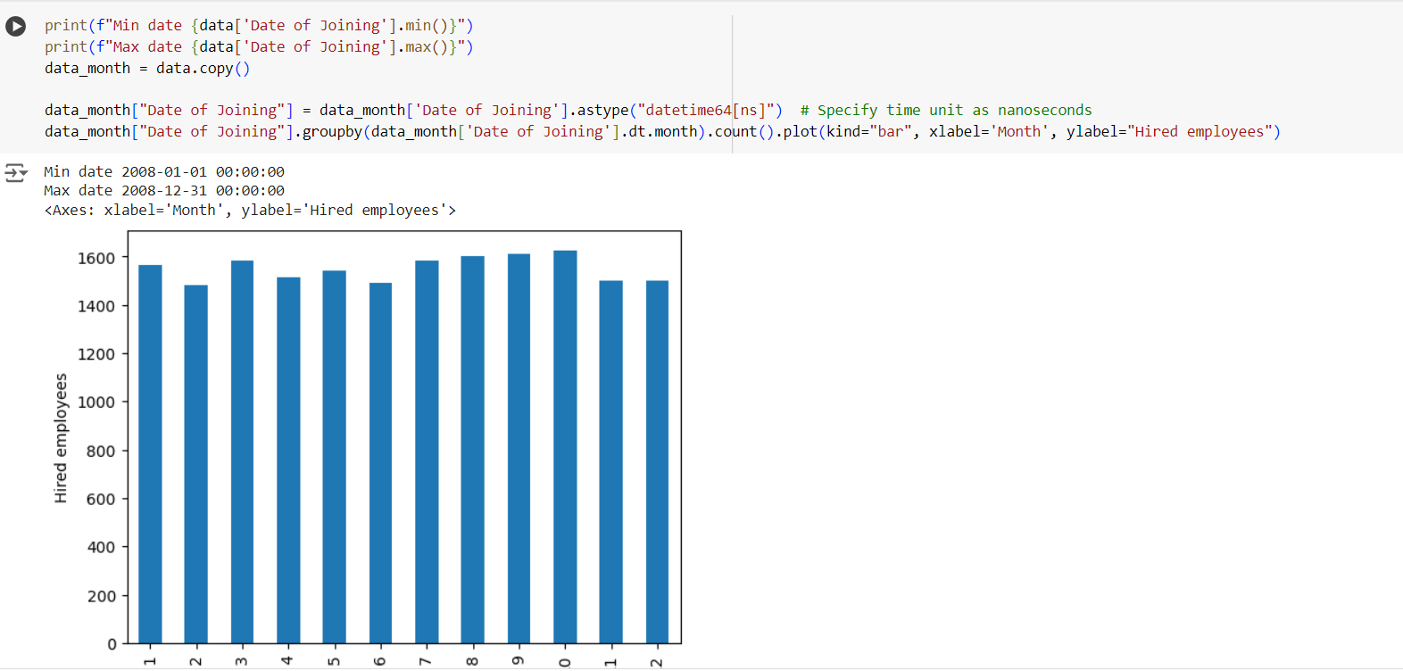
Analysing Categorical Data
The Employee ID column was eliminated since it doesn't influence the burn rate. To evaluate the effect of the Date of Joining column, it was transformed into a DateTime format, and each employee's employment duration in days was calculated

Slide 12
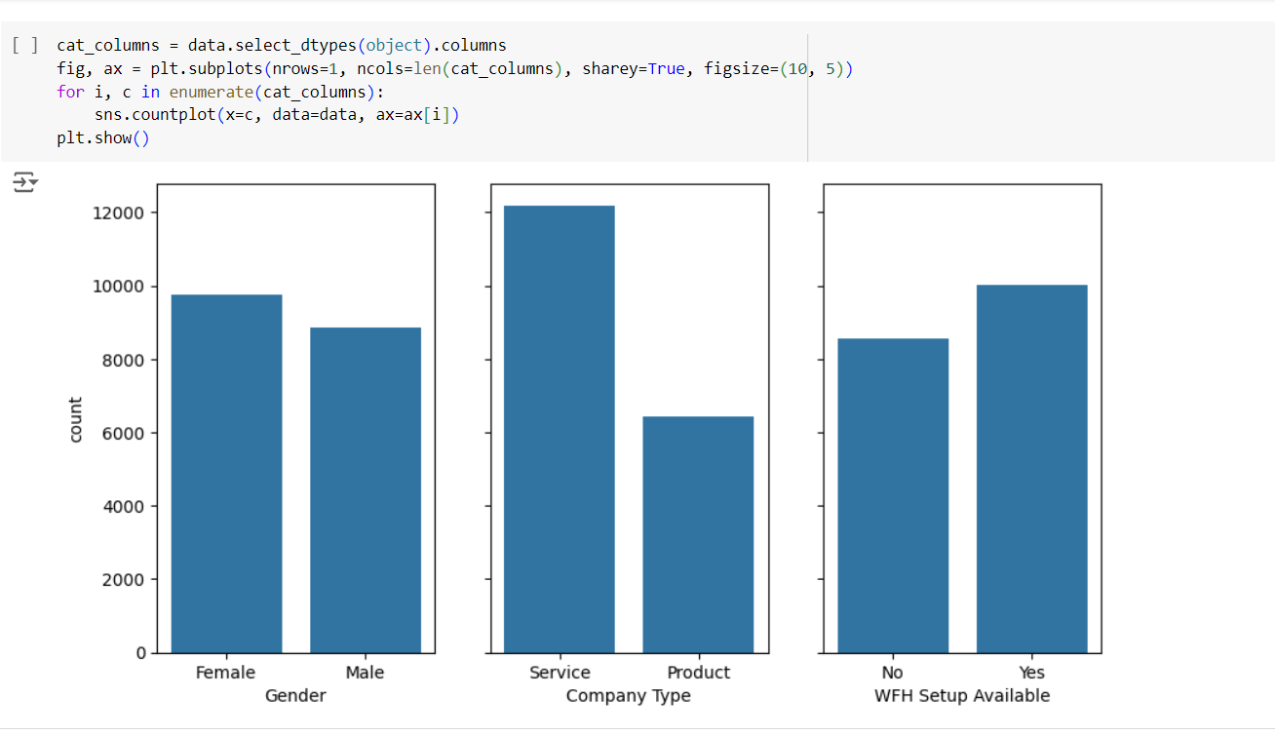
Analysing Categorical Data
We then analyzed the remaining categorical columns and proceeded further with our analysis. Our conclusion revealed that the data in each column is normally distributed, except for the Company Type column.

Slide 13
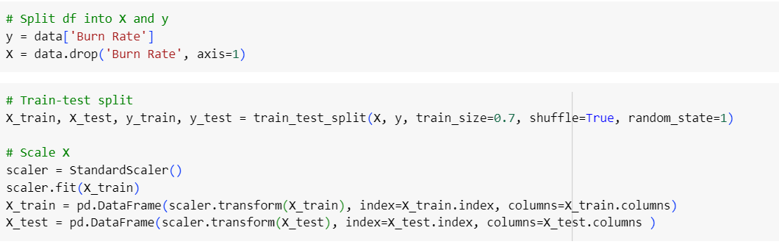
Data Splitting And Scaling
We divided the dataset into training and testing sets with a 7:3 ratio to train the linear regression model. To scale the features, we used a standard scaler to standardize the data, ensuring each feature has a mean of 0 and a standard deviation of 1.

Slide 14
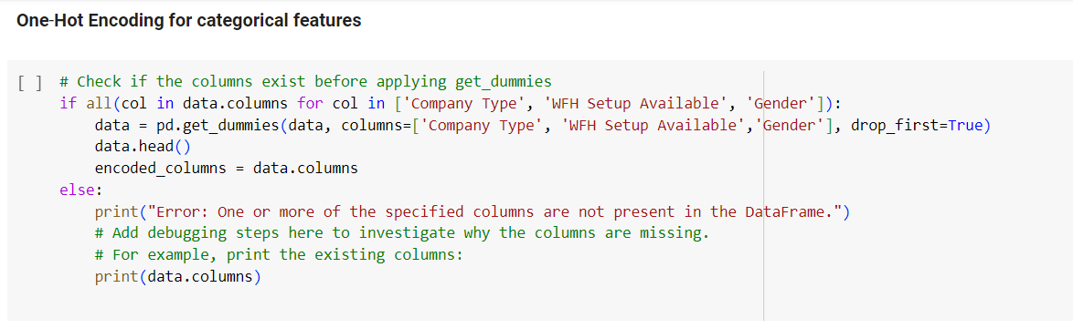
One Hot Encoding
We utilized one-hot encoding to transform categorical data into a numerical format appropriate for our predictive model. This method entails encoding the categorical values with dummy numerical values, allowing the machine learning algorithms to handle this information efficiently.

Slide 15
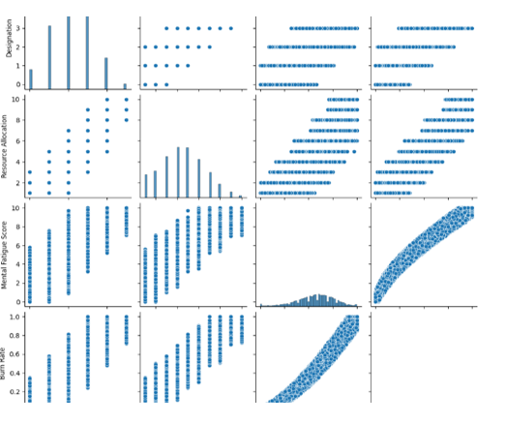
results
Two variables are strongly correlated with the target variable, therefore, important to estimate it.

Slide 16
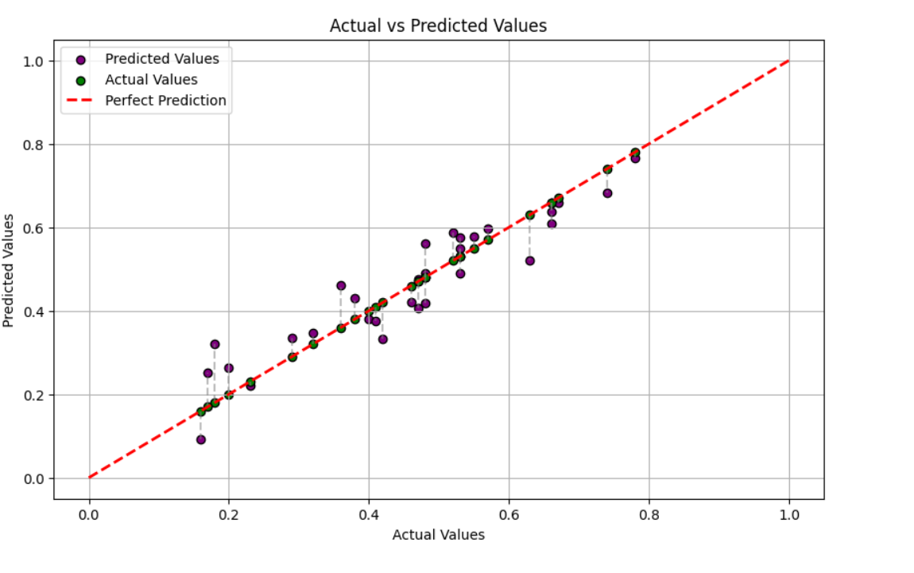
RESULTS
We visualized the actual versus predicted values for 30 randomly chosen samples on a best-fit line, demonstrating the alignment between the model's predictions and the actual burn rate values. This visualization provides insights into the model's accuracy and performance.

Slide 17
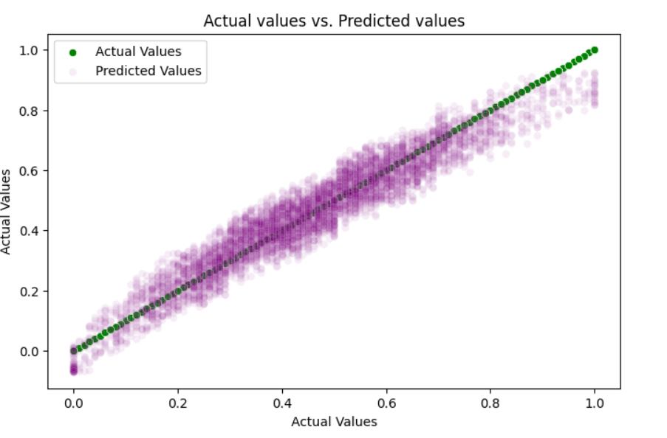
RESULTS
The plot illustrates the actual versus predicted values for the burn rate, with the red dotted line representing the regression line fitted by the model. This visualization aids in assessing the model's accuracy by comparing the predicted burn rates to the actual values.

Slide 18
LINKS
CO-Lab Link: https://colab.research.google.com/drive/106yTshwC6bCrCxkWOYLX11DOVoEkp93C
Dataset From Kaggle: https://www.kaggle.com/datasets/blurredmachine/are-your-employees-burning-out
GitHub link: https://github.com/nikhitha1188/Edunet-Internship.git
Email ID: nikhitha_yarajarla@srmap.edu.in

Slide 19
THANK YOU

